Slide 1
Bayesian analysis of keyword frequencies in on-line news articles
Kian Varu
Kari Heine

Slide 2
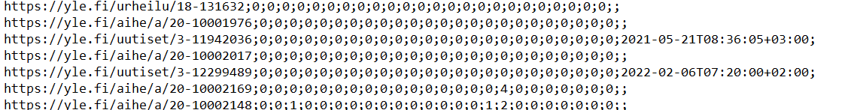
The data
Our data is scraped from a Finnish Website over a period of 8 months
Articles scan for 35 keywords e.g. climate, government
There are 28,000 datapoints mostly with empty data across two different datasets indexed by the date

Slide 3
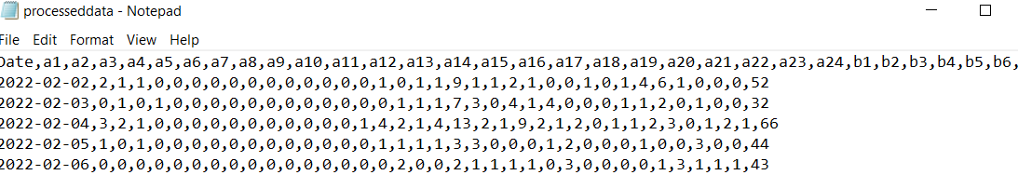
Data
Use Python and Object Oriented Programming with 2 classes - Analysis to process our data analysis and Model for SMC
We perform an outer join on the data
Group our data by date
Convert date
Store a counter for the number of articles on a given day
Truncate data from February this year to get rid of the old entries

Slide 4
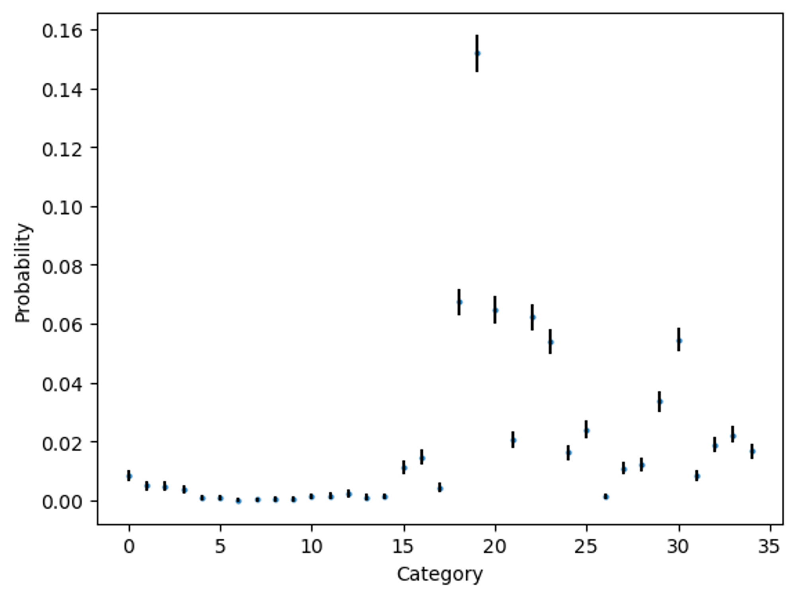
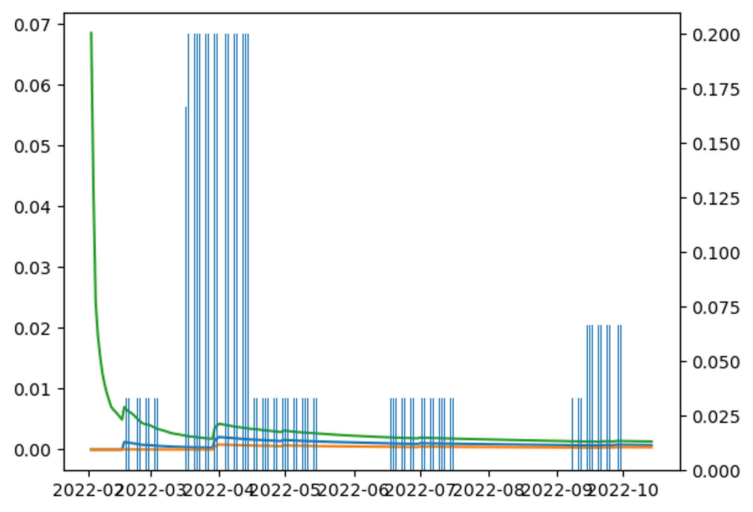
Inference from the probability of a keyword occurring

Slide 5
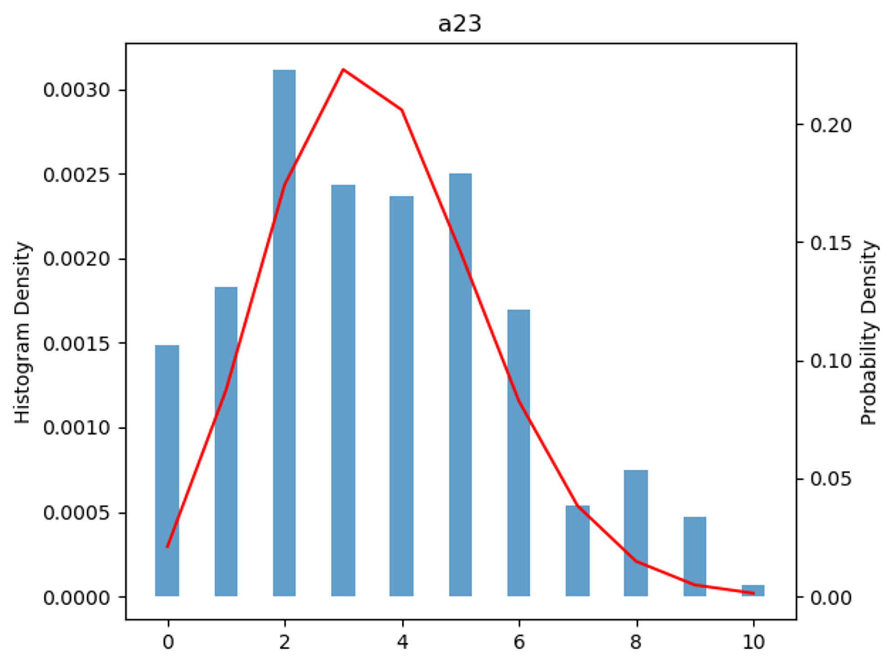
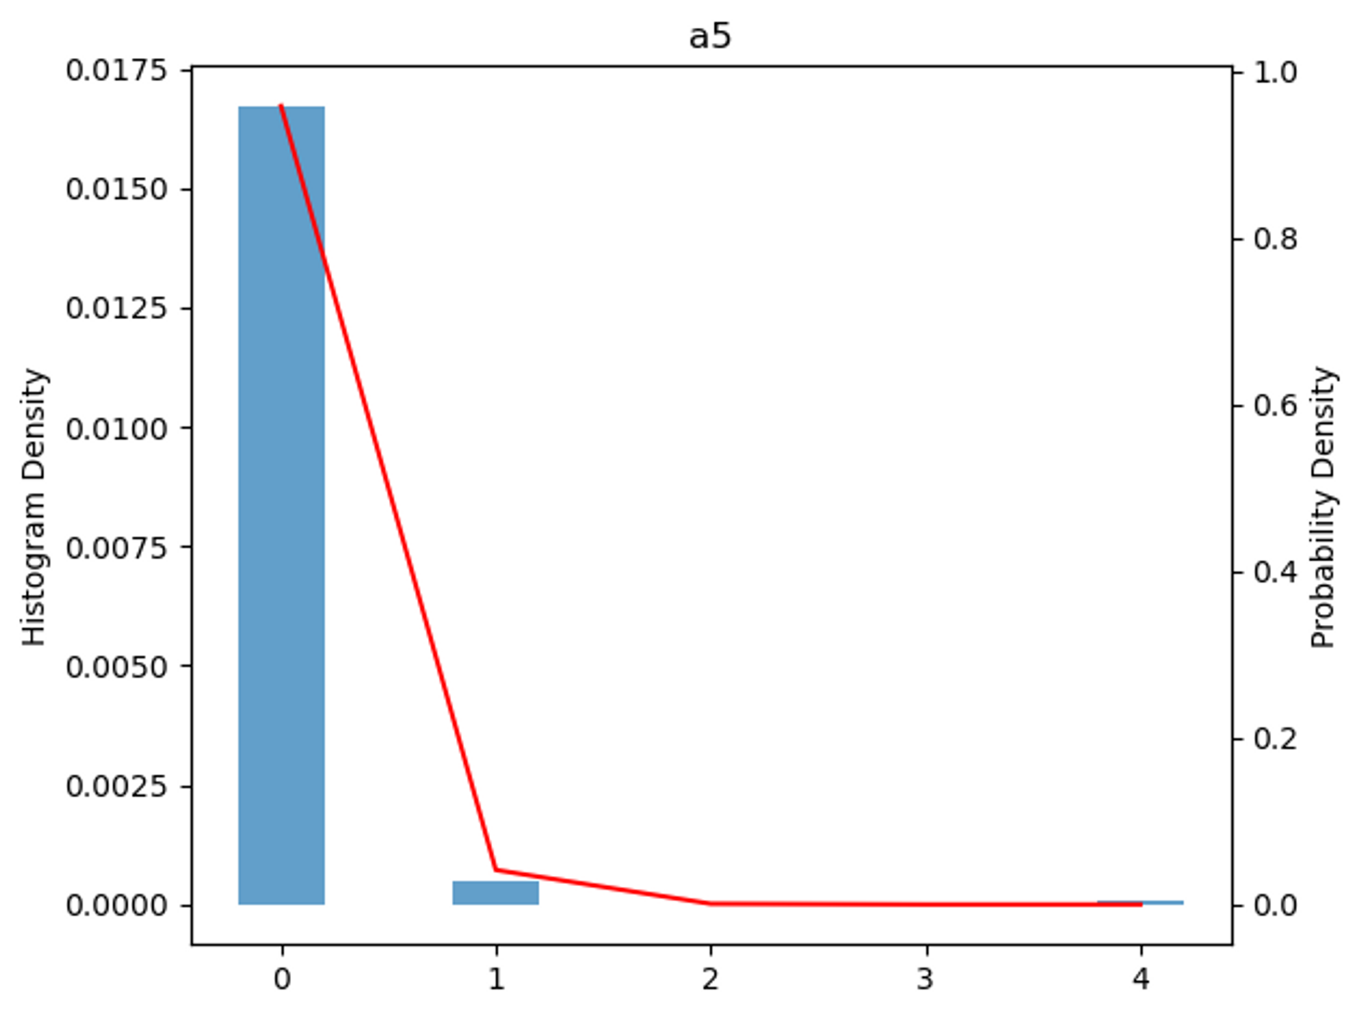
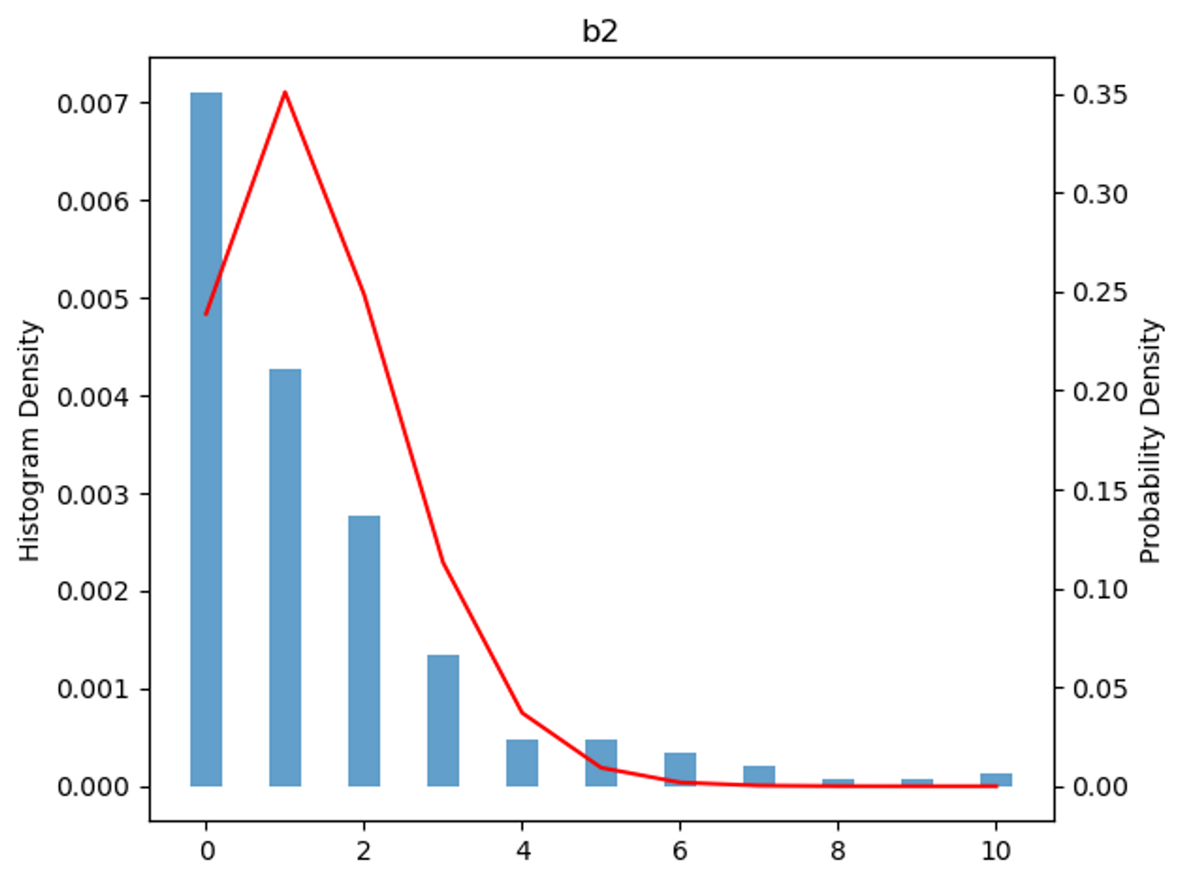
Binomial?

Slide 6

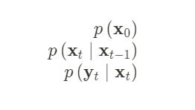


SMC
1. Predictive Distribution
2. Observation
3. Filter Distribution

Slide 7
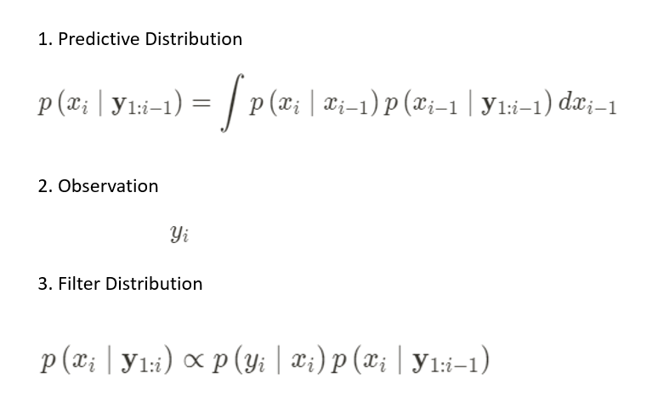
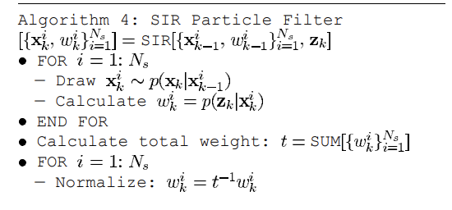
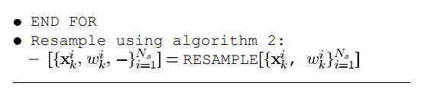
Filter Pseudo

Slide 8
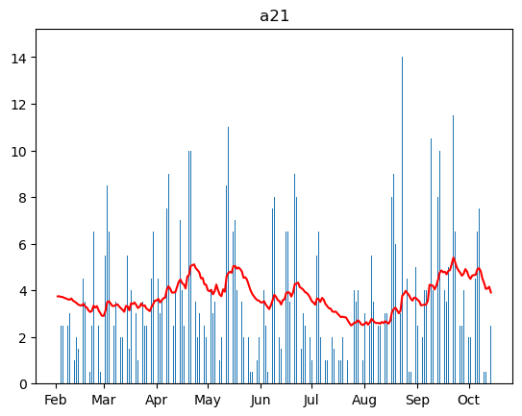
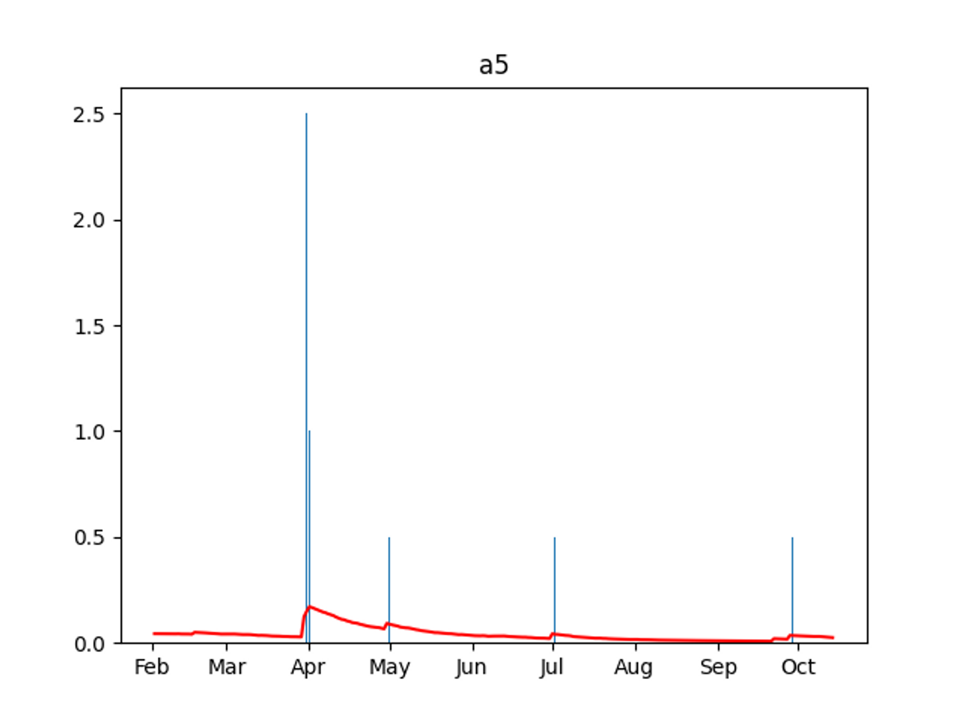


Slide 9
